Slide 1

Influence of Global Population, Fossil Fuel Consumption and GDP on CO2 Emissions
Presented by Team JAST
Julie Winkle
Abhiniti Mahendrakar
Solanda Dufresne
Tanzeania Saylor

Slide 2
Intro
What is the purpose of our project? (Questions asked)
Understanding and analyzing global carbon footprints of fossil fuel types by world region.
What role does population and GDP have on CO2 emissions over time?
How has the world energy demand contributed to global CO2 emissions?
Hypothesis: Increase in global population will result in increased CO2 emissions.
Null Hypothesis: The relationship between global population and CO2 emissions is not significant.
Hypothesis: Increase in global GDP will result in increased CO2 emissions.
Null Hypothesis: The relationship between GDP and CO2 emissions is not significant.
Hypothesis: Increase in global fossil fuel consumption will result in increased CO2 emissions.
Null Hypothesis: The relationship between fossil fuel consumption and CO2 emissions is not significant.

Slide 3
Questions & Data
Understanding and analyzing global carbon footprints by fossil fuel type by world region.
Data set: Our source was the International Energy Agency, “IEA CO2 Emissions from Fuel Combustion, OECD/IEA, Paris, 2017”. Data set has a breakdown of CO2 emissions by fossil fuel by Region and Country.
What role does population and GDP have in CO2 emissions over time?
Data set: Our source was the World Bank, “World Development Indicators, GDP/Population Growth”. Time series by World Development Indicator.
How has the world energy demand contributed to global CO2 emissions?
Data sets: World Resource Institute “CAIT Climate Data Explorer, 2017”,
Our World in Data “Global fossil fuel consumption”. Time series by energy demand and Total fossil fuel emissions.

Slide 4
Data Cleanup & Exploration
Describe the exploration and cleanup process
Global warming is such a vast topic, so initially we were pulling data from many sources on different aspects of global warming.
Since sources were credible and data was already probably cleaned up, our cleanup process mainly involved formatting to visualize the data.
Discuss insights you had while exploring the data that you didn't anticipate
Cleaning our data set helped us fine tune our project topic.
Discuss any problems that arose after exploring the data, and how you resolved them
From some organizations’ websites, data is sometimes not readily accessible/free NOAA website was down for maintenance

Slide 5
Data Analysis
Steps taken to analyze data:
Searched for data sets to answer project questions. Gathered data sets from the IEA, World Bank, World Resource Institute Resource and Our World in Data websites.
Decided what to measure and how to measure it.
What role does population and GDP have in CO2 emissions over time?
Created graphs that compares the CO2 emissions over time to global population and GDP.
How has the world energy demand contributed to global CO2 emissions?
Compared the global CO2 emissions to the world’s demand for coal, crude oil, and natural gas.

Slide 6
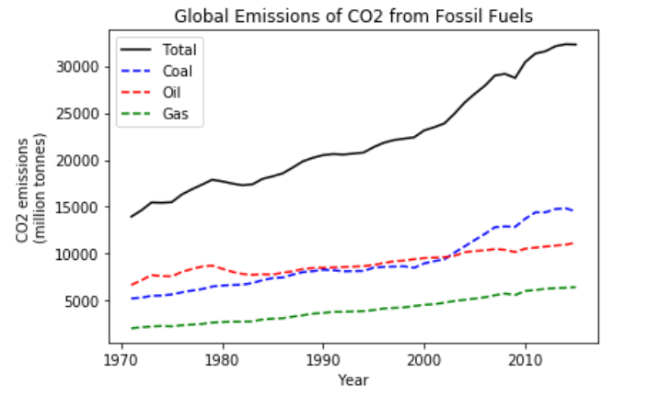
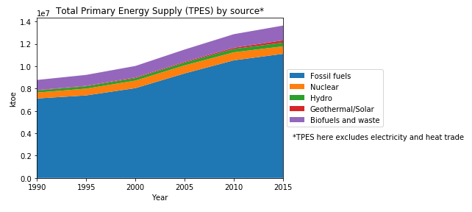
Background - Global Energy sources
*Fossil fuels account for 81.1% of total primary energy supply
*At year 2015, coal makes up 45.2% of CO2 emissions from fossil fuels

Slide 7
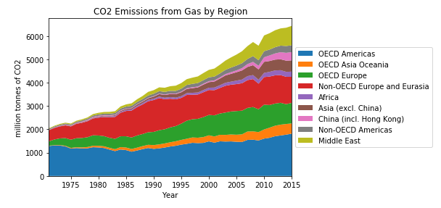
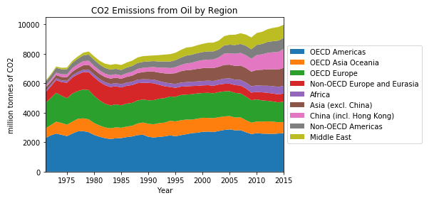
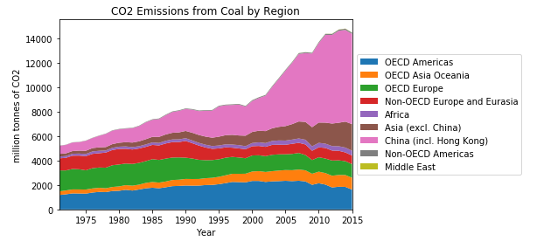
Overview of Global CO2 Emissions by region
Top emitter by fossil fuel
Coal: China 31.9% (total over time) 51.0% (2015)
Oil: *OECD Americas 30.8% (US, CA, MX, CL)
Gas: OECD Americas 33.7% ,
Non-OECD Europe and Eurasia 25.5% (Russia)
*OECD (Organization for Economic Co-operation and Development)

Slide 8
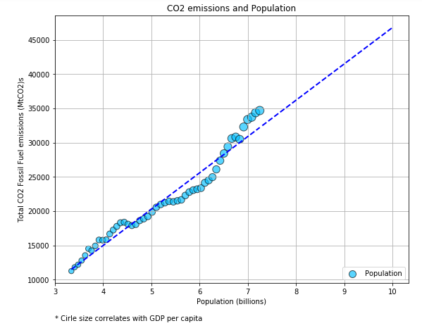
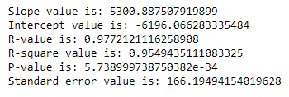
Contributing factors: Population
95.5% of the total variability in CO2 emissions is explained by its regression on Population.
If global population grows based on this linear model, we will emit approximately 46,812 (MtCO2) in 2055 once we reach a population of 10 billion people per UN estimates.

Slide 9
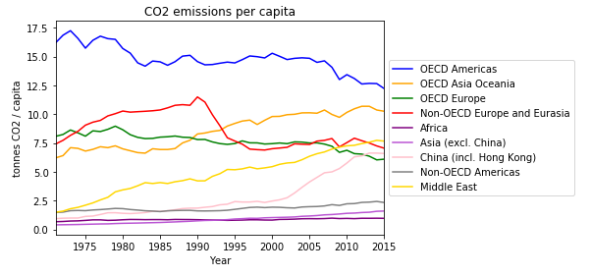
Contributing factors: CO2 emissions per capita
In 1971, a person in the OECD Americas produced 17.3 times more tonnes of CO2 than a person in China.
In 2015, a person in the OECD Americas produced 1.9 times more tonnes of CO2 than a person in China.
*OECD Americas (United States, Canada, Mexico and Chile.

Slide 10
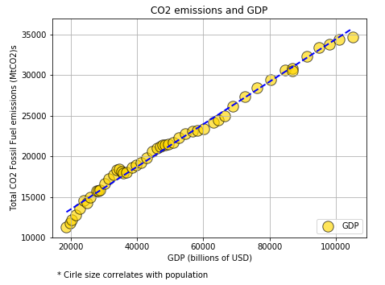
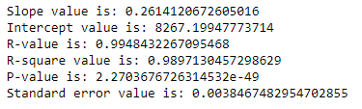
Contributing factors: GDP
98.97% of the total variability in CO2 emissions is explained by its regression on GDP.

Slide 11
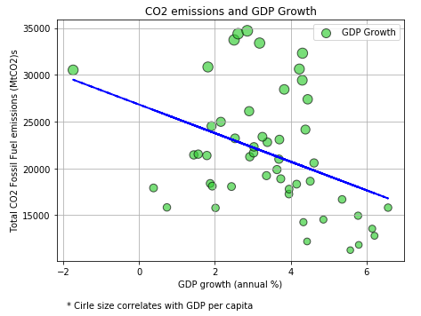
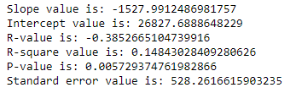
Contributing factors: GDP Growth
14.84% of the total variability in CO2 emissions is explained by its regression on X GDP Growth.

Slide 12
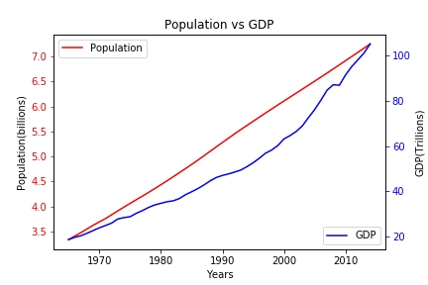
Population vs GDP Comparison

Slide 13
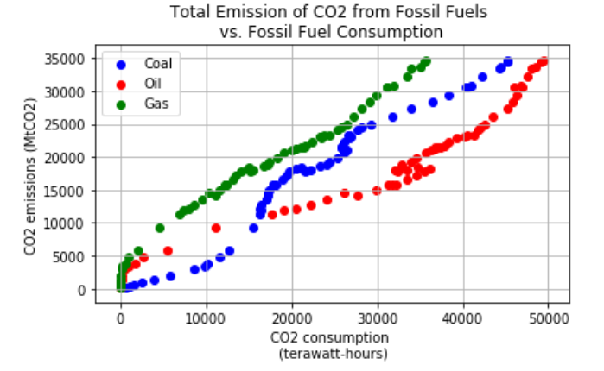
Regression analysis: CO2 Emissions vs Fossil Fuel Consumption

Slide 14
Dep. Variable: | Total CO2 Fossil Fuel emissions (MtCO2) | R-squared: | 0.998
Model: | OLS | Adj. R-squared: | 0.998
Method: | Least Squares | F-statistic: | 1.008e+04
Date: | Sat, 28 Jul 2018 | Prob (F-statistic): | 8.23e-65
Time: | 10:57:26 | Log-Likelihood: | -346.38
No. Observations: | 50 | AIC: | 700.8
Df Residuals: | 46 | BIC: | 708.4
Df Model: | 3
Covariance Type: | nonrobust
 | coef | std err | t | P>|t| | [0.025 | 0.975]
const | 449.6660 | 404.421 | 1.112 | 0.272 | -364.392 | 1263.724
Coal consumption (terawatt-hours) | 0.3698 | 0.019 | 19.053 | 0.000 | 0.331 | 0.409
Crude oil consumption (terawatt-hours) | 0.1941 | 0.019 | 10.425 | 0.000 | 0.157 | 0.232
Natural gas consumption (terawatt-hours) | 0.2044 | 0.032 | 6.341 | 0.000 | 0.140 | 0.269

Slide 15
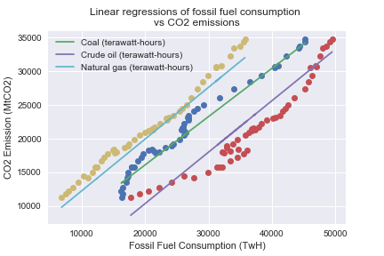
Coal Slope value is: 0.7159557159035506 Coal Intercept value is: 2502.12593280504 Coal R-value is: 0.9860780314166474 Coal R-square value is: 0.972349884042306 Coal P-value is: 4.6304870982307086e-39 Coal Standard error value is: 0.017426201724543653 ------------------------------------------------- Oil Slope value is: 0.7626066781813275 Oil Intercept value is: -6393.87773199279 Oil R-value is: 0.9577155437463142 Oil R-square value is: 0.9172190627332982 Oil P-value is: 1.2804678831868618e-27 Oil Standard error value is: 0.03306805253812809 ----------------------------------------------------- Gas Slope value is: 0.7672870431976115 Gas Intercept value is: 5984.682281870968 Gas R-value is: 0.99315923916755 Gas R-square value is: 0.9863652743438668 Gas P-value is: 1.9653163882239408e-46 Gast Standard error value is: 0.013020916704700345

Slide 16
Summary of findings
Understanding and analyzing global carbon footprints by fossil fuel type by world region.
At year 2015, coal makes up 45.2% of Total CO2 emissions from fossil fuels.
China is the top emitter of CO2 emissions produced by coal total since 1971 (31.9%) and in year 2015 (51%).
What role does population and GDP have in CO2 emissions over time?
Population and GDP have a positive correlation with CO2 emissions.
How has the world energy demand contributed to global CO2 emissions?
World energy consumption has a positive correlation with Global CO2 emissions.
Implications of our findings:
Based on our analysis, we can reject our Null hypotheses.
The relationship between fossil fuel consumption , population and GDP with CO2 emissions is significant.

Slide 17
Post Mortem
Problems Team JAST faced:
Defining the scope of our project.
Issues with locating data sets that related to project objectives.
If we would have had more time we would have analyzed:
CO2 emissions as it relates to global temperatures via time lapse model.
CO2 emissions from non fossil fuel sources such as agriculture.
Exponential modeling for variable population.

Slide 18


Thank you!
Any Questions?

